Slide 1


Software Quality Engineering

Slide 2
Software Testing

Slide 3

Home task
Sandwich testing

Slide 4
Types of Black box Testing

Slide 5
Types of black box testing
Install/uninstall testing
Recovery testing
Compatibility testing
Comparison testing
Alpha testing
Beta testing
Mutation testing
Functional testing
System testing
End-to-end testing
Sanity testing
Regression testing
Acceptance testing
Load testing
Stress testing

Slide 6
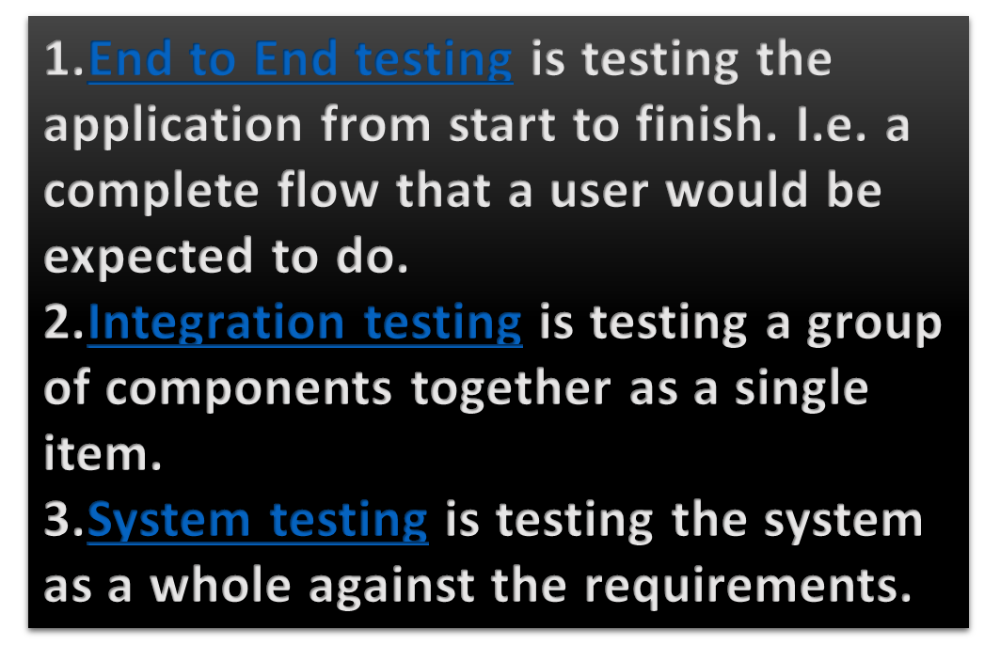
Checking login functionality
Functional testing is a type of software testing that verifies that each function of the software application operates in conformance with the requirement specification. It focuses on what the software does .
Functional testing
Black box type testing geared to functional requirements of an application.
System testing
Black box type testing that is based on overall requirements specifications; covering all combined parts of the system.
End-to-end testing
Similar to system testing; involves testing of a complete application environment in a situation that mimics real-world use.
Testing the entire process of booking a flight ticket online
End-to-end testing is performed after system testing and before acceptance testing.
Notes:
System testing is performed on a complete system while integration testing is performed on a subset of the system
System testing checks the behaviors of the system as a whole while integration testing checks the data transferring among multiple modules of the system
It is the level of testing where the complete integrated application is tested as a whole.
It aims at determining if the application conforms to its business requirements.
System testing is carried out in an environment that is very similar to the production environment.
Integration testing can be both black box and white box

Slide 7
Sanity testing
Initial effort to determine if a new software version is performing well enough to accept it for a major testing effort.
Regression testing
Re-testing after fixes or modifications of the software or its environment.
Acceptance testing
Final testing based on specifications of the end-user or customer.
Sanity Testing is a type of software testing that is performed after receiving a software build. The goal is to determine that the proposed functionality works approximately as expected.
Regression testing is a software testing practice that ensures an application still functions as expected after any code changes, updates, or improvements. Regression testing is responsible for the overall stability and functionality of the existing features
Notes:
Sanity testing ensures that the software is ready for the next level of testing.

Slide 8
Load testing
Testing an application under heavy loads.
Eg. Testing of a web site under a range of loads to determine, when the system response time degraded or fails.
Stress Testing
Testing under unusually heavy loads, heavy repetition of certain actions or inputs, input of large numerical values, large complex queries to a database etc.
Term often used interchangeably with ‘load’ and ‘performance’ testing.
Performance testing
Testing how well an application complies to performance requirements
Testing the app with maximum number of user and input is defined as load testing. While testing the app with more than maximum number of user and input is defined as stress testing.
Load is beyond the expected threshold.
Notes:
Performance testing is a type of software testing that is used to test the speed, response time, stability, reliability, scalability, and resource usage of a software application under a particular workload. The main purpose of performance testing is to identify and eliminate the performance bottlenecks in the software application

Slide 9
Install/uninstall testing
Testing of full, partial or upgrade install/uninstall process.
Recovery testing
Testing how well a system recovers from crashes, HW failures or other problems.
Compatibility testing
Testing how well software performs in a particular HW/SW/OS/NW environment.
Comparison testing
Comparing SW strengths and weakness to competing products.
Recovery testing is a type of system testing which aims at testing whether a system can recover from failures or not. The technique involves failing the system and then verifying that the system recovery is performed properly. Recovery testing is important to perform to ensure that a system is fault-tolerant and can recover well from failures
Printing software ….

Slide 10
Alpha testing
Testing done when development is nearing completion; minor design changes may still be made as a result of such testing.
Beta-testing
Testing when development and testing are essentially completed and final bugs and problems need to be found before release.
Mutation testing
To determining if a set of test data or test cases is useful, by deliberately introducing various bugs.
Re-testing with the original test data/cases to determine if the bugs are detected.
. Beta testing is performed by a group of external users who are not part of the development team and who use the software in a real-world environment. The main goal of beta testing is to identify any remaining defects or issues with the software that were not discovered during the internal testing phase. The feedback obtained from the beta testers can be used to make any necessary changes or improvements to the software before its final release.
Mutation testing is a type of software testing technique that is used to evaluate the effectiveness of a software testing process. It involves introducing small, deliberate changes (known as "mutations") into the code to see if the existing tests can detect these changes. The main goal of mutation testing is to identify weaknesses in the test suite by evaluating how well it can detect these changes.

Slide 11
White box Testing

Slide 12
White box testing / Structural testing
Based on knowledge of internal logic of an application's code
Based on coverage of code statements, branches, paths, conditions.
Tests are logic driven.
Notes:
a branch typically refers to an alternative path or a set of instructions within a program that is executed only if a certain condition is met.

Slide 13
Control Flow Testing
A type of white box testing
Based on the flow of control in the program.
  Logical decisions
  Loops
  Execution paths
  Coverage metrics
  Measure of how complete the test cases are.
Notes:
Control flow testing is a type of white-box testing that involves testing the flow of control structures in a program. Control structures in a program include loops, conditionals (if-else statements, switch statements, etc.), and other control structures that direct the flow of execution within the program. Control flow testing aims to ensure that the program behaves correctly under all possible control flow scenarios.
In control flow testing, test cases are designed to exercise all possible paths or routes that the program can take as it executes. The purpose of this testing is to ensure that the program behaves as intended under all possible control flow scenarios, including edge cases and unusual scenarios.

Slide 14
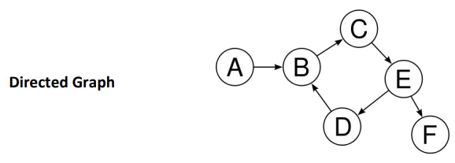
Control Flow Graph
A control-flow graph (CFG) is a representation, using graph notation, of all paths that might be traversed through a program during its execution.

Slide 15
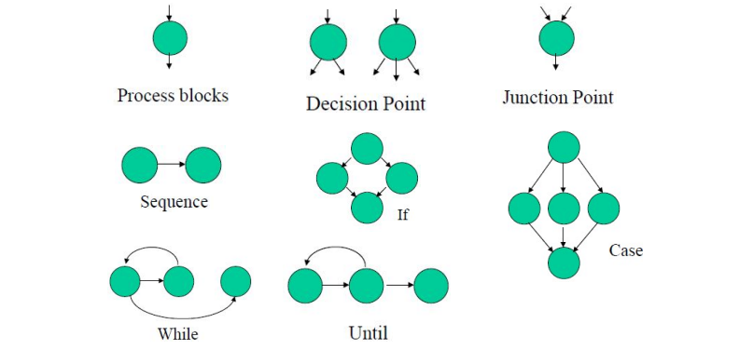
Control Flow Graph

Slide 16
A junction is a point in the program where the control flow can merge
Control Flow Graph
A process block is a sequence of program statements which are not interrupted by either decisions or junctions If any one of the statements of the block is executed, then all followed statements are executed Process block contains a piece of straight line code of one statement or hundreds of statements A process has one entry and one exit
A decision is a program point at which the control flow can diverge

Slide 17
Steps to Draw Control Flow Graph
Number all the statements of a program.
Numbered statements: represent nodes of the control flow graph.
An edge from one node to another node exists: if execution of the statement representing the first node can result in transfer of control to the other node.

Slide 18
Program flow graph
Basic Control Flow Graph
class IfStatement {
public static void main(String[] args) {
int number = 10;
if (number > 0) {
System.out.println("The number is positive.");
}
else {
System.out.println("The number is negative.");
}
System.out.println("Statement outside if block");
}
}

Slide 19
Coverage:
Statement Coverage:
In this scheme, statements of the code are tested for a successful test that checks all the statements lying on the path of a successful scenario.
Branch Coverage:
In this scheme, all the possible branches of decision structures are tested. Therefore, sequences of statements following a decision are tested.
Path Coverage:
In path coverage, all possible paths of a program from input instruction to the output instruction are tested. An exhaustive list of test cases is generated and tested against the code.

Slide 20
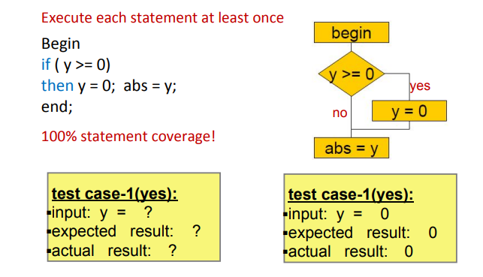
Statement Coverage

Slide 21
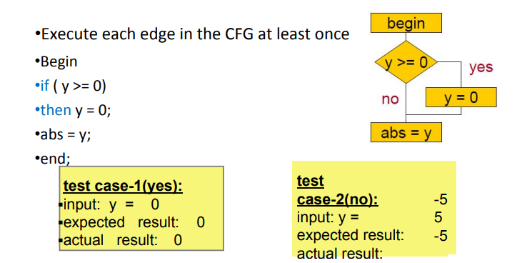
Decision/Branch Coverage
Every statement in the program has been executed at least once, and every decision in the program has taken all possible outcomes at least once.

Slide 22
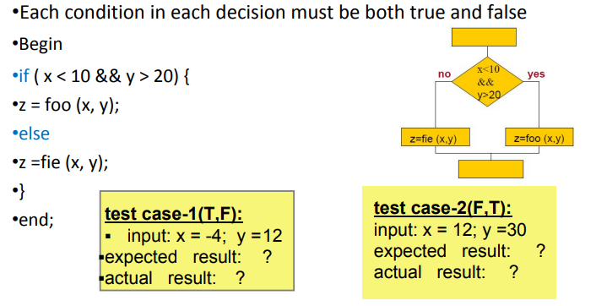
Decision/Condition Coverage

Slide 23
Path coverage
A path is a sequence of branches, or conditions.
A path corresponds to a test case, or a set of inputs.
In code coverage testing, branches have more importance than the blocks they connect.
Bugs are often sensitive to branches and conditions

Slide 24
McCabe’s Complexity Metric
Cyclomatic Complexity is a software metric that provides a Quantitative measure of the logical complexity of a program.

Slide 25
McCabe’s Complexity Metric
The cyclomatic complexity of the program is computed from its control flow graph (CFG) using the formula:
V(G) = Edges – Nodes + 2
or by counting the conditional statements and adding 1
This measure determines the basis set of linearly independent paths and tries to measure the complexity of a program.
Notes:
In the context of cyclomatic complexity, V(G) represents the cyclomatic complexity of a program's control flow graph.
V stands for "voltage", which is a term borrowed from circuit theory and refers to the number of independent paths that can be taken through a program's control flow graph.
G stands for "graph", which refers to the control flow graph itself, a directed graph that represents the program's control flow, with nodes representing basic blocks of code and edges representing the control flow between them.
Together, V(G) is a notation used to represent the cyclomatic complexity of the program's control flow graph, which is a measure of the number of independent paths through the program's source code.

Slide 26
Cyclomatic Complexity
V(G) = Edges – Nodes + 2
V(G) = 6 – 6 + 2 = 2
V(G) = conditional statements + 1
= 1 + 1 = 2
Two linearly independent paths:
1, 2, 5, 6
1, 2, 3, 4, 2, 5, 6
Complexity = 2 < 10 => good quality
1
2
3
4
5
6

Slide 27
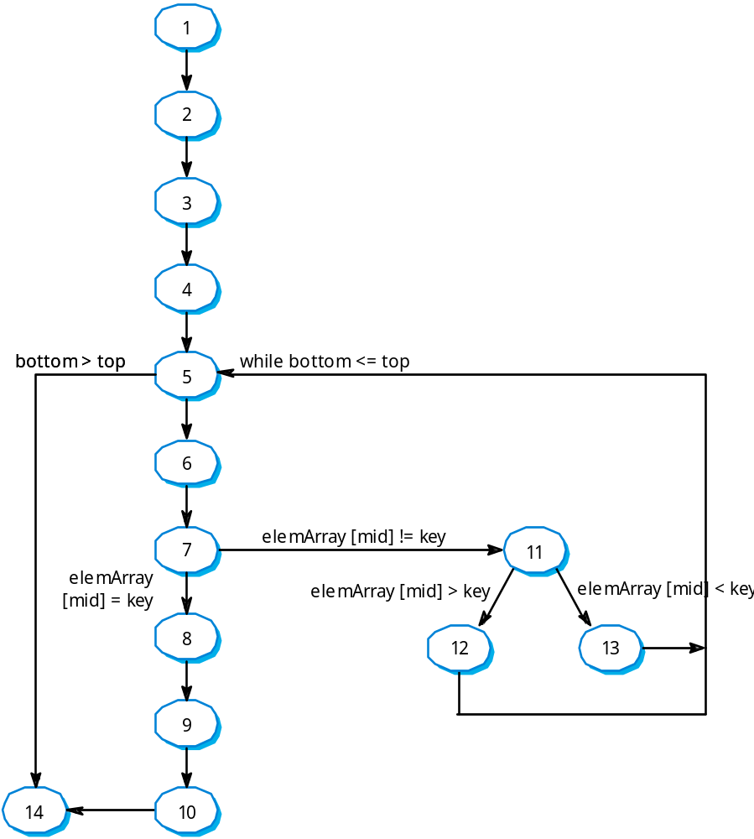
V(G) = Edges – Nodes + 2
V(G) = 16 – 14 + 2 = 4
V(G) = conditional statements + 1
= 3 + 1 = 4
four linear independent paths
Complexity = 4 < 10 => good quality

Slide 28
Cyclomatic Complexity
V(G) | Risk
1 – 10 | easy program, low risk
11 – 20 | complex program, tolerable risk
21 – 50 | complex program, high risk
>50 | impossible to test, extremely high risk

Slide 29
The cyclomatic complexity indicates the number of possible execution paths through a program. A higher cyclomatic complexity value indicates that the program has more complex logic and is potentially more difficult to understand, test, and maintain.
A program with a lower cyclomatic complexity is generally considered to be more straightforward and easier to understand and maintain. Therefore, the cyclomatic complexity value can be used as a rough indicator of a program's complexity, maintainability, and testability.
It's important to note that the cyclomatic complexity value is not an absolute measure of a program's quality or maintainability, and should be used in conjunction with other metrics and analysis techniques to fully evaluate a program's code quality.

Slide 30
Applicability and limitation
Control flow testing is the basis of unit testing.
It should be used for all modules of code that cannot be tested sufficiently through reviews and inspections.
Its limitation are that the tester must have sufficient programming skill to understand the code and its control flow
Control flow testing can be very time consuming.

Slide 31


